Slide 1

Transcriptomic Data Analysis
Jędrzej Jakub Szymański
IPK Gatersleben & FZJ Jülich

Slide 2
Transcriptomic Data Analysis
Jędrzej Jakub Szymański
IPK Gatersleben & FZJ Jülich
“Transcriptomic data analysis in the middle ages” DALL-E2 generative AI model

Slide 3
Lectures in the series
1. Introduction to Transcriptomic Data
2. Study Design, Annotation, and Data Import
3. Filtering and Normalization of Transcriptomic Data
4. Data Analysis - Multivariate Statistics and Visualization
5. Accessing Public Data
6. Differential Gene Expression
7. Functional Enrichment Analysis

Slide 4
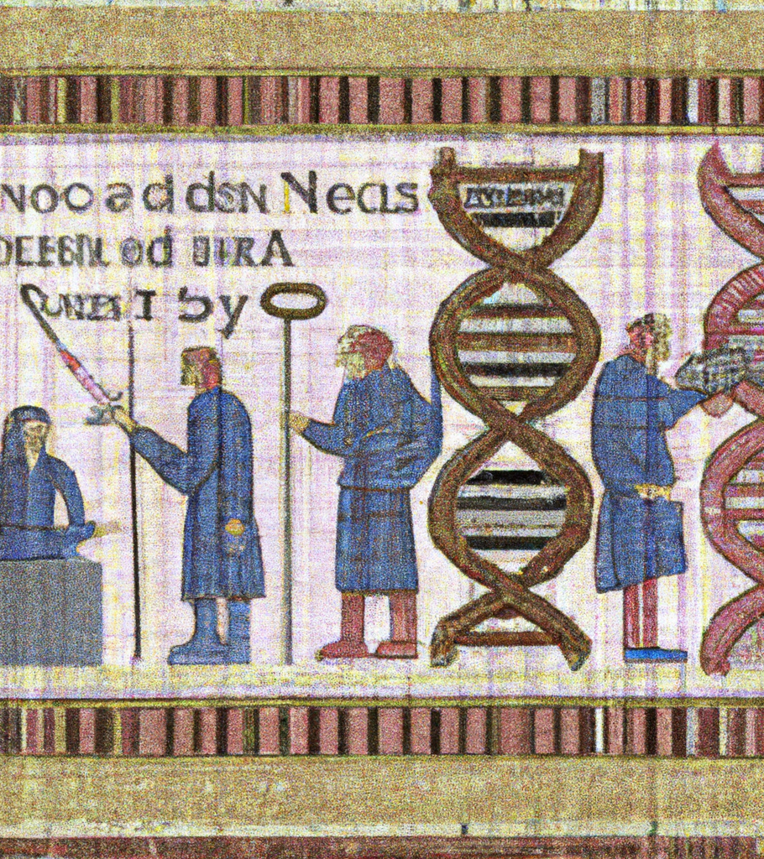
Introduction to Transcriptomic Data
What we can learn from transcriptomic data?
Introduction to data formats
Basic definitions - read, read count, transcript length, RPKM, TPM
Start an RStudio Project directory that we’ll use for the rest of the course.
Open and discuss our first script, including installation of packages

Slide 5
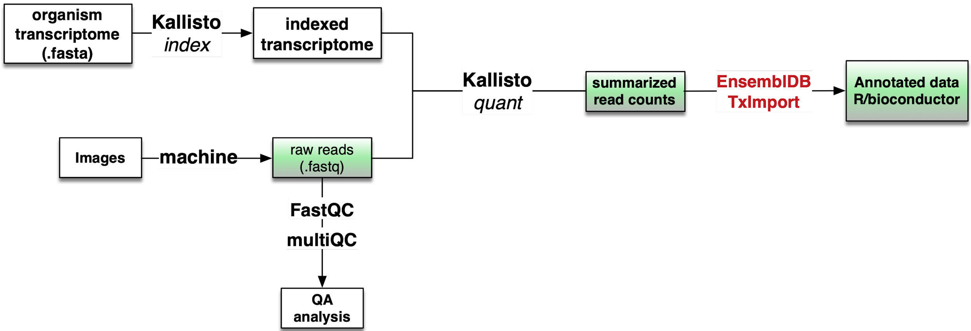
Tracking our workflow in this course
Step 1 script
Don’t worry if you’ve struggled with QA or read mapping!
Notes:
point at data folders with kallisto output

Slide 6
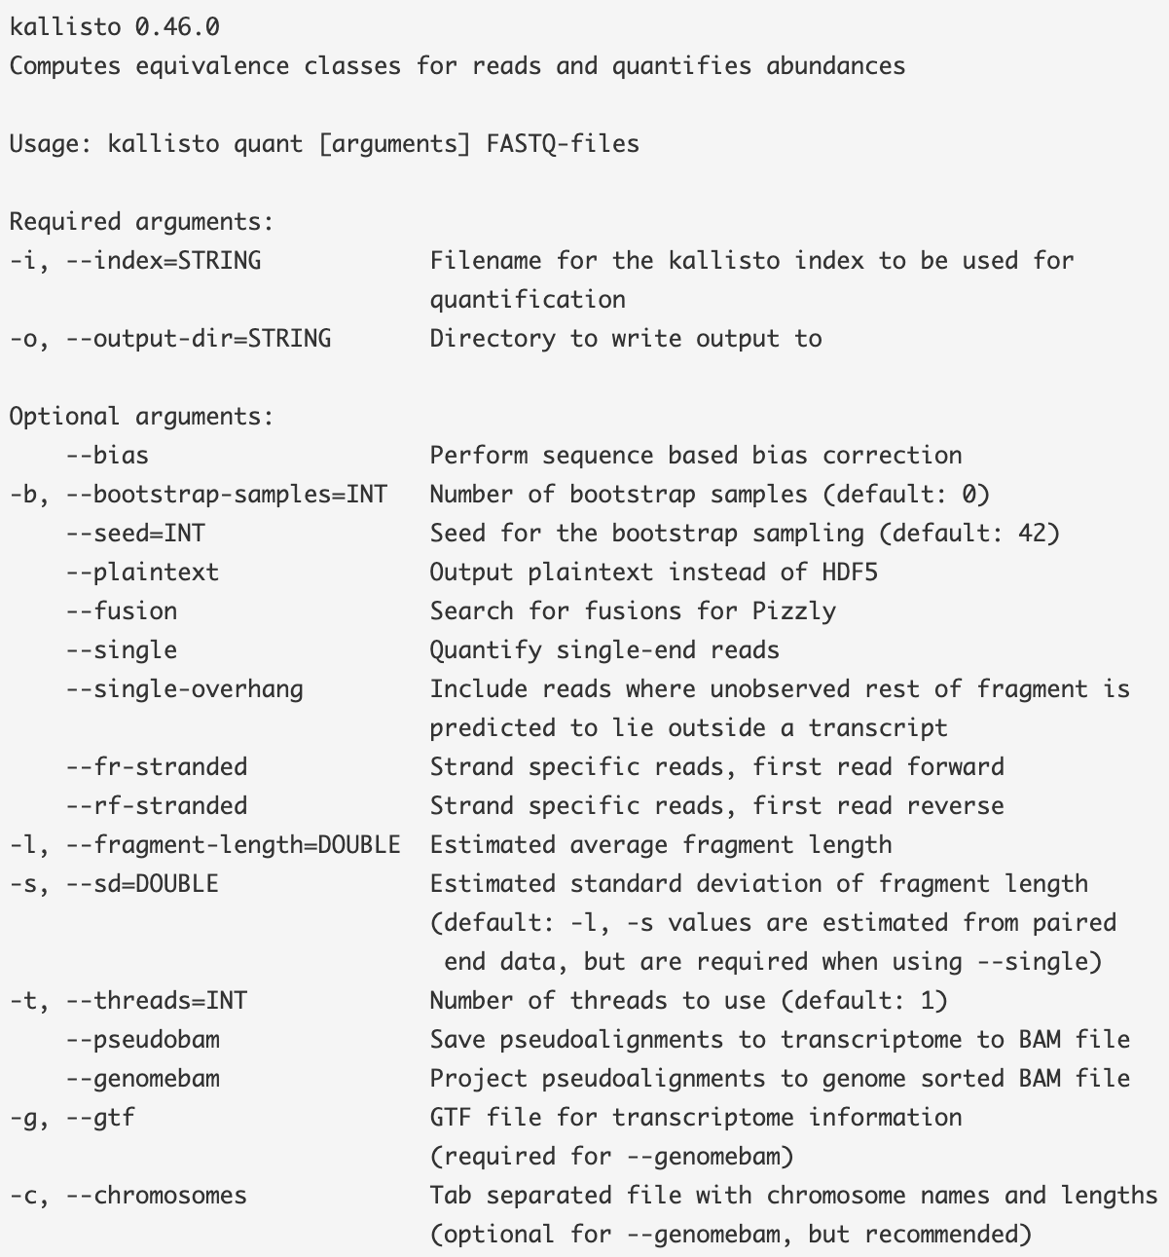
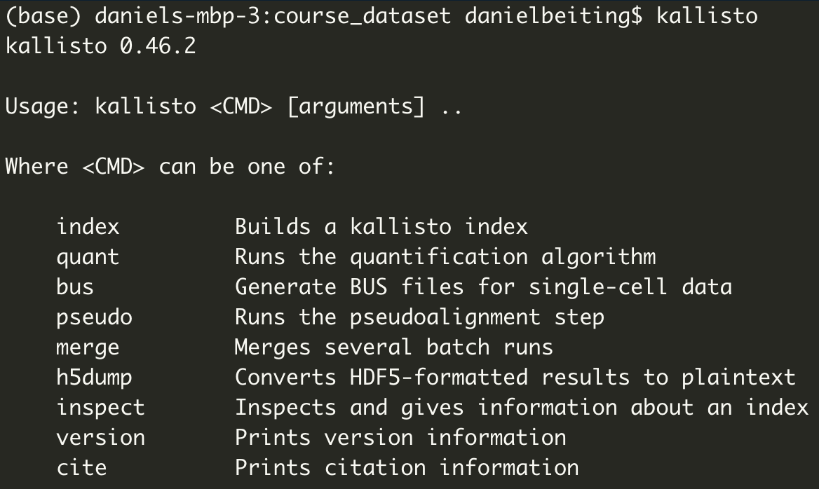


Explore other Kallisto functions on your own
Notes:
things that we didnt explore in kallisto, e.g. generation of BAM files

Slide 7
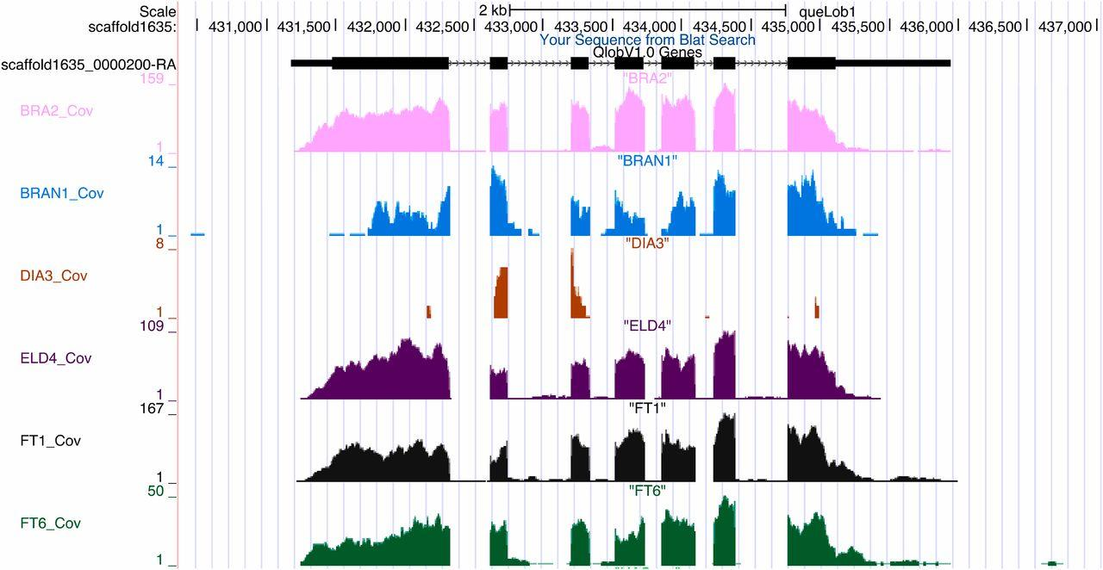
Using Kallisto (pseudoalignment) is a flexible strategy for handling many types of seq experiments
Notes:
genome browser tracks - piled up reads

Slide 8
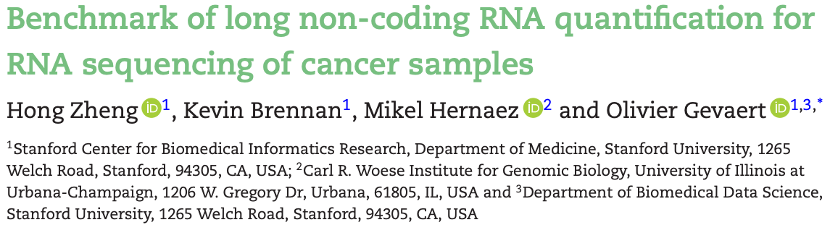
Pseudoalignment also performs well for lowly expressed transcripts (e.g. lncRNAs)
“In this benchmarking study, we compared the performance of pseudoalignment methods Kallisto and Salmon, and alignment based methods HTSeq, featureCounts, and RSEM, in lncRNA quantification, by applying them to a simulated RNA-Seq dataset and a pan-cancer RNA-Seq dataset from TCGA.”
“In summary, pseudoalignment methods Kallisto or Salmon in combination with the full transcriptome annotation is our recommended strategy for RNA-Seq analysis for lncRNAs.”
Zheng et al, GigaScience, 2019
Notes:
kallisto are particularly good for long noncoding RNAs

Slide 9
protocols.hostmicrobe.org/compute/kallisto

Slide 10
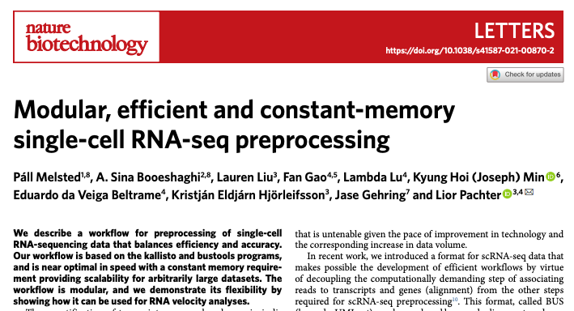
Kallisto ‘bus tools’ for scRNAseq
Notes:
kallisto is useful for single cell data

Slide 11

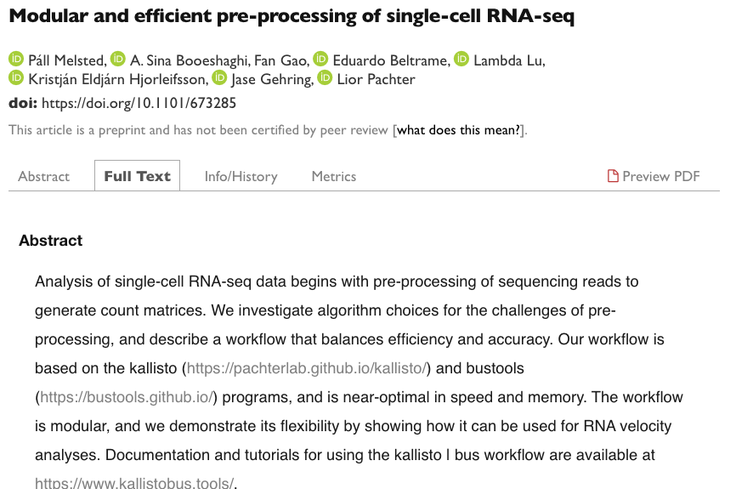

Kallisto ‘bus tools’ for scRNAseq
“Our scRNA-seq workflow is up to 51 times faster than CellRanger…[and] requires a small fixed amount of constant memory that is independent of the number of reads being pre-processed. It is therefore suitable for low-cost and environmentally conscious cloud computing”
Processed ~400M scRNAseq reads in ~16 min, compared to ~16 hours with Cell Ranger.

Slide 12
Open Kallisto output
run_info.json

Slide 13
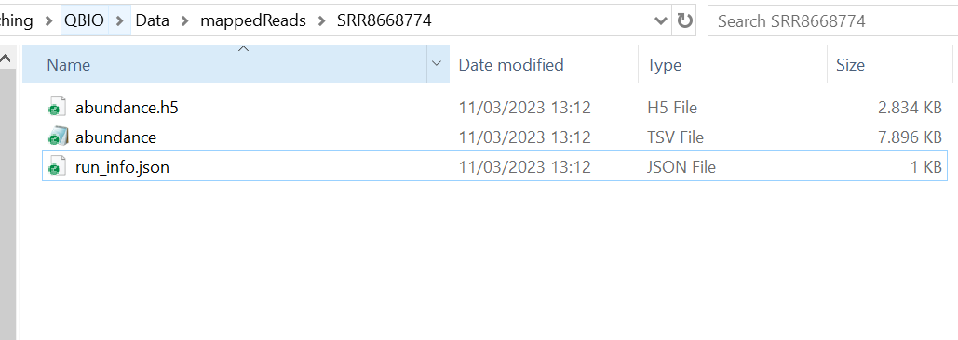
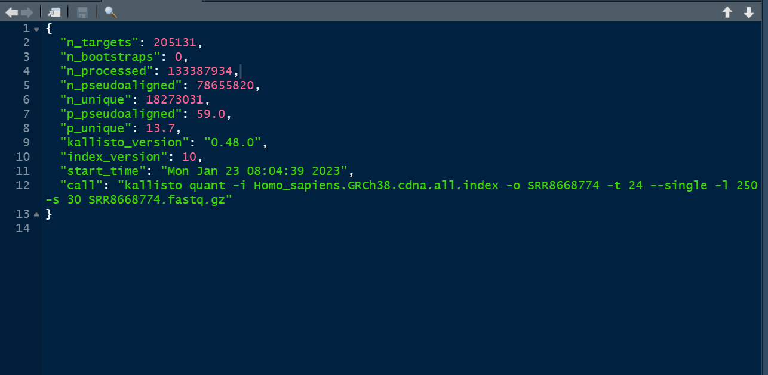

Slide 14
Open Kallisto output
abundance.tsv

Slide 15
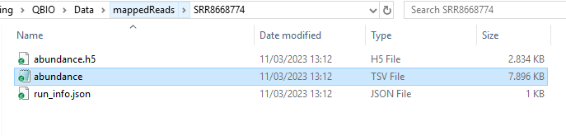
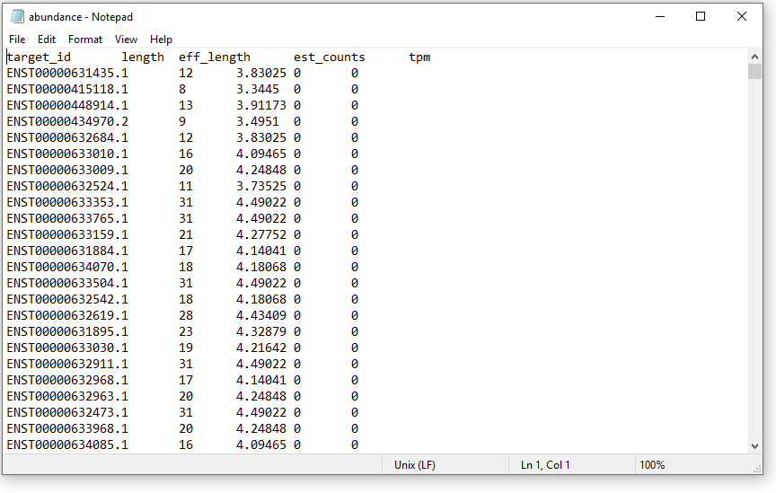
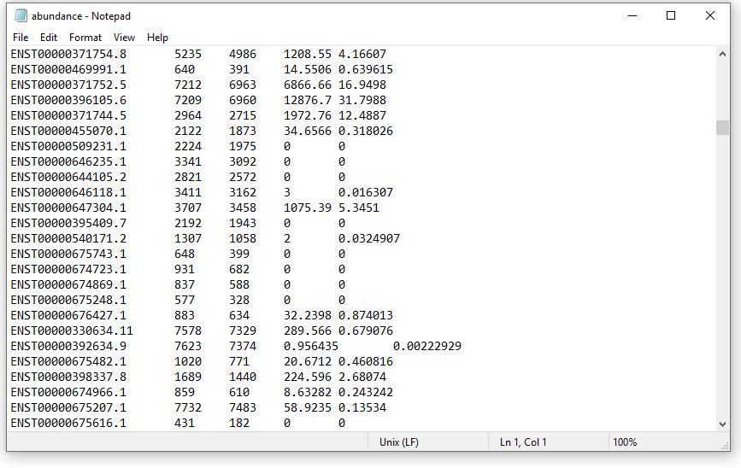

Slide 16
Notes:
how we get from ect counts to tpm?

Slide 17
The ‘effective length’ of a transcript
The length of a transcript after adjusting for the total number of possible positions a fragment of size X could originate from
L _{effective}
=
L _{actual}
-
L _{fragment}
+
1
transcript
ATGCGTAACATG
L _{actual} = 12
L _{effective} = 10
fragment
NNN
L _{fragment} = 3
ATGCGTAACATG
Notes:
when we talk about length we mean effective length

Slide 18
RNAseq gives relative quantification of gene expression
“All commonly used techniques to measure mRNA abundance, including qPCR, microarray signals, as well as reads per kilobase per million reads (RPKM) for RNAseq data, aim at estimating a statistic that is as closely proportional to the relative molar concentration as possible.”
- Wagner, Theories in Biosci., 2012
Notes:
RNAseq is not quantitative, its a relative measure
pin this concept or relative expression

Slide 19
Understanding units of measurement for RNAseq is critical to understanding how we determine differential expression
Notes:
thats the basis for best unit for reflecting the relative expression

Slide 20
Normalization
generic term referring to any number of ways that a dataset is globally altered to improve our ability to detect DEGs
Notes:
what does it mean to normalize data?
in practice not always improve

Slide 21
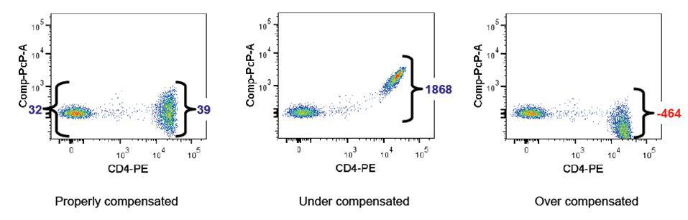
RNAseq normalization ≈
Flow cytometry compensation
Notes:
FITC (fluorescein isothiocyanate) is a green fluorescent dye that is excited by blue light and emits green-yellow fluorescence. FITC is often used to label markers such as CD8, CD4, and CD45 on cells.
PE (phycoerythrin) is a red-orange fluorescent dye that is excited by green-yellow light and emits orange-red fluorescence. PE is often used to label markers such as CD3, CD4, and CD25 on cells.

Slide 22
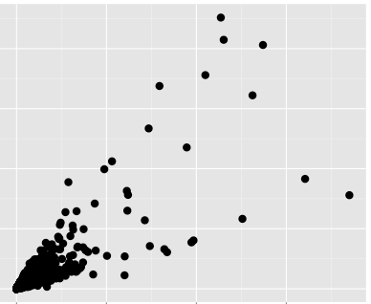
raw counts
 | mouse 1 | mouse 2 | mouse 3 | mouse 4 | mouse 5 | StDev
gene A | 5 | 10 | 10 | 15 | 10 | 3.5
gene B | 115 | 110 | 100 | 115 | 118 | 7.1
gene C | 1000 | 1100 | 1050 | 1045 | 1030 | 36.4
gene D | 8000 | 9000 | 10000 | 6000 | 7030 | 1576.4
genes with higher expression have higher stdDev
Median expression
Heteroscedasticity
StdDev
Notes:
simple numbers to show what happens to data when we tweak it
formula and meaning of variance
formula and meaning of standard deviation?
formula and meaning of coefficient of variation
Hetero sce das ticity

Slide 23
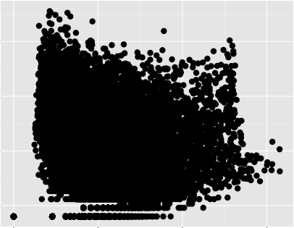
Log 2
 | mouse 1 | mouse 2 | mouse 3 | mouse 4 | mouse 5 | StDev
gene A | 2.3 | 3.3 | 3.3 | 3.9 | 3.3 | 0.57
gene B | 6.8 | 6.8 | 6.6 | 6.8 | 6.9 | 0.09
gene C | 10.0 | 10.1 | 10.0 | 10.0 | 10.0 | 0.05
gene D | 13.0 | 13.1 | 13.3 | 12.6 | 12.8 | 0.29
With large datasets, fixing one problem often creates another
Median log 2 expression
genes with lower expression have highest StdDev
StdDev
Notes:
fix one problem and create another

Slide 24
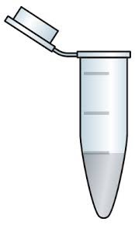

expected reads per sample
.fastq
.fastq
.fastq
.fastq
Single fastq
Pool
Sequence
.fastq
.fastq
.fastq
.fastq
Notes:
each sample is barcoded, indexed

Slide 25
expected reads per sample
^
actual
.fastq
.fastq
.fastq
.fastq
Single fastq
Pool
Sequence
.fastq
.fastq
.fastq
.fastq

Slide 26
scaling units for between libraries
.fastq
sample1
exon 1
exon 2
e 3
.fastq
sample 2
exon 1
exon 2
e 3
scale to
unit depth
sample1
sample2
sample1
sample2

Slide 27
scaling units for within-sample comparisons
.fastq
sample1
gene A
1kb
gene B
1kb
exon 1
exon 2
exon 3
exon 1
scale to
unit length
gene A
gene B
gene A
gene B
Notes:
use gene and transcript interchangeably

Slide 28
reads per kilobase, per million reads sequenced (RPKM)
sample1
exon 1
exon 2
e 3
between
sample
Original RPKM ref: Mortazavi A. et al., Nature Methods 2008
RPKM is really just a unit of expression for RNAseq data
sample 2
exon 1
exon 2
e 3
+
gene A
1kb
gene B
1kb
within
sample
exon 1
exon 2
exon 3
exon 1
Notes:
rpkm - reads per kilobase per million reads
fpkm - fragments (for paired end data)
not normalization really, adjusting for length and depth of sequencing

Slide 29
RPKM (FPKM)
# reads mapped to genomic region
RPKM =
(region length in kb)(total # reads)

Slide 30
RPKM (FPKM)
# reads mapped to genomic region
RPKM =
(region length in kb)(total # reads)
1000
RPKM =
= 0.00001
(5)(20000000)

Slide 31
RPKM (FPKM)
# reads mapped to genomic region
RPKM =
x 10⁶
(region length in kb)(total # reads)
1000
RPKM =
= 0.00001
(5)(20000000)

Slide 32
RPKM (FPKM)
# reads mapped to genomic region
RPKM =
x 10⁶
(region length in kb)(total # reads)
1000
RPKM =
= 10
(5)(20000000)

Slide 33
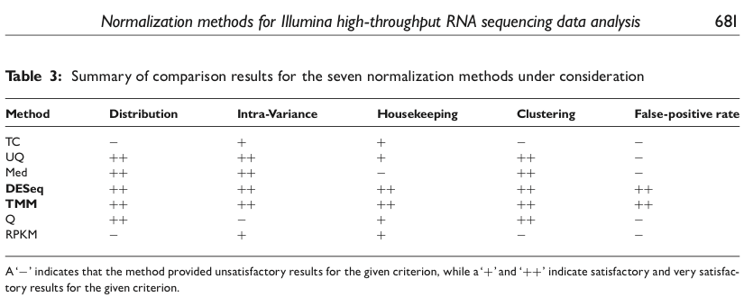
RPKM alone, is not sufficient for normalization
DESeq
EdgeR
Diilies et al., Briefings in Bioinformatics, Sept 2012

Slide 34

The problem with RPKM
read counts from each gene
 | Gene A 100kb | Gene B 50kb | Gene C 25kb | Gene D 5kb | Gene E 1kb | total reads
Sample 1 | 80 | 10 | 6 | 3 | 1 | 100
Sample 2 | 20 | 20 | 10 | 50 | 400 | 500
# reads mapped to genomic region
RPKM =
x 10⁶
(region length in kb)(total # reads)
RPKM each gene
 | Gene A 100kb | Gene B 50kb | Gene C 25kb | Gene D 5kb | Gene E 1kb | total RPKM
Sample 1 | 8000 | 2000 | 2400 | 6000 | 10000 | 28400
Sample 2 | 400 | 800 | 800 | 20000 | 800000 | 822000

Slide 35
RNAseq gives relative quantification of gene expression
“All commonly used techniques to measure mRNA abundance, including qPCR, microarray signals, as well as reads per kilobase per million reads (RPKM) for RNAseq data, aim at estimating a statistic that is as closely proportional to the relative molar concentration as possible.”
- Wagner, Theories in Biosci., 2012

Slide 36
“The average relative molar concentration for each and every sample of RNA-seq data mapped to the same genome is the same constant value.
- Wagner, Theories in Biosci., 2012

Slide 37
The problem with RPKM
read counts from each gene
 | Gene A 100kb | Gene B 50kb | Gene C 25kb | Gene D 5kb | Gene E 1kb | total reads
Sample 1 | 80 | 10 | 6 | 3 | 1 | 100
Sample 2 | 20 | 20 | 10 | 50 | 400 | 500
# reads mapped to genomic region
RPKM =
x 10⁶
(region length in kb)(total # reads)
RPKM each gene
 | Gene A 100kb | Gene B 50kb | Gene C 25kb | Gene D 5kb | Gene E 1kb | total RPKM
Sample 1 | 8000 | 2000 | 2400 | 6000 | 10000 | 28400
Sample 2 | 400 | 800 | 800 | 20000 | 800000 | 822000
μ = 5680
μ = 164400

Slide 38
Fixing RPKM is easy
read count
 | Gene A 100kb | Gene B 50kb | Gene C 25kb | Gene D 5kb | Gene E 1kb | total reads
Sample 1 | 80 | 10 | 6 | 3 | 1 | 100
Sample 2 | 20 | 20 | 10 | 50 | 400 | 500
this becomes a normalization factor
scale by gene length first
 | Gene A 100kb | Gene B 50kb | Gene C 25kb | Gene D 5kb | Gene E 1kb | total RPK
Sample 1 | 0.8 | 0.2 | 0.24 | 0.6 | 1 | 2.84
Sample 2 | 0.2 | 0.4 | 0.4 | 10 | 400 | 411

Slide 39
Fixing RPKM is easy
reads per Kb
TPM =
total RPK in sample
 | Gene A 100kb | Gene B 50kb | Gene C 25kb | Gene D 5kb | Gene E 1kb | total RPK
Sample 1 | 0.8 | 0.2 | 0.24 | 0.6 | 1 | 2.84
Sample 2 | 0.2 | 0.4 | 0.4 | 10 | 400 | 411

Slide 40
Fixing RPKM is easy
reads per Kb
TPM =
total RPK in sample
 | Gene A 100kb | Gene B 50kb | Gene C 25kb | Gene D 5kb | Gene E 1kb | total RPK
Sample 1 | 0.8/2.84 | 0.2/2.84 | 0.24/2.84 | 0.6/2.84 | 1/2.84 | 2.84
Sample 2 | 0.2/411 | 0.4/411 | 0.4/411 | 10/411 | 400/411 | 411
 | Gene A 100kb | Gene B 50kb | Gene C 25kb | Gene D 5kb | Gene E 1kb | total RPK
Sample 1 | 0.8 | 0.2 | 0.24 | 0.6 | 1 | 2.84
Sample 2 | 0.2 | 0.4 | 0.4 | 10 | 400 | 411

Slide 41
Fixing RPKM is easy
 | Gene A 100kb | Gene B 50kb | Gene C 25kb | Gene D 5kb | Gene E 1kb | total TPM
Sample 1 | 0.281690141 | 0.070422535 | 0.084507042 | 0.211267606 | 0.352112676 | 1
Sample 2 | 0.000486618 | 0.000973236 | 0.000973236 | 0.0243309 | 0.97323601 | 1
reads per Kb
TPM =
total RPK in sample
 | Gene A 100kb | Gene B 50kb | Gene C 25kb | Gene D 5kb | Gene E 1kb | total RPK
Sample 1 | 0.8/2.84 | 0.2/2.84 | 0.24/2.84 | 0.6/2.84 | 1/2.84 | 2.84
Sample 2 | 0.2/411 | 0.4/411 | 0.4/411 | 10/411 | 400/411 | 411
 | Gene A 100kb | Gene B 50kb | Gene C 25kb | Gene D 5kb | Gene E 1kb | total RPK
Sample 1 | 0.8 | 0.2 | 0.24 | 0.6 | 1 | 2.84
Sample 2 | 0.2 | 0.4 | 0.4 | 10 | 400 | 411

Slide 42
Fixing RPKM is easy
 | Gene A 100kb | Gene B 50kb | Gene C 25kb | Gene D 5kb | Gene E 1kb | total TPM
Sample 1 | 0.281690141 | 0.070422535 | 0.084507042 | 0.211267606 | 0.352112676 | 1
Sample 2 | 0.000486618 | 0.000973236 | 0.000973236 | 0.0243309 | 0.97323601 | 1
 | Gene A 100kb | Gene B 50kb | Gene C 25kb | Gene D 5kb | Gene E 1kb | total TPM
Sample 1 | 281690 | 70423 | 84507 | 211268 | 352113 | 1000000
Sample 2 | 487 | 973 | 973 | 24331 | 973236 | 1000000
μ = 200000
μ = 200000
reads per Kb
TPM =
x 10⁶
total RPK in sample
 | Gene A 100kb | Gene B 50kb | Gene C 25kb | Gene D 5kb | Gene E 1kb | total RPK
Sample 1 | 0.8/2.84 | 0.2/2.84 | 0.24/2.84 | 0.6/2.84 | 1/2.84 | 2.84
Sample 2 | 0.2/411 | 0.4/411 | 0.4/411 | 10/411 | 400/411 | 411
 | Gene A 100kb | Gene B 50kb | Gene C 25kb | Gene D 5kb | Gene E 1kb | total RPK
Sample 1 | 0.8 | 0.2 | 0.24 | 0.6 | 1 | 2.84
Sample 2 | 0.2 | 0.4 | 0.4 | 10 | 400 | 411

Slide 43
Further normalization steps need to be taken before one can compare between samples
“library size scaling is too simple for many biological applications. The number of fragments expected to map to a gene is not only dependent on the expression level and length of the gene, but also the composition of the RNA population that is being sampled. Thus, if a large number of genes are unique to, or highly expressed in, one experimental condition, the sequencing 'real estate' available for the remaining genes in that sample is decreased. If not adjusted for, this sampling artifact can force the DE analysis to be skewed towards one experimental condition. ”
“library size scaling is too simple for many biological applications. The number of fragments expected to map to a gene is not only dependent on the expression level and length of the gene, but also the composition of the RNA population that is being sampled. Thus, if a large number of genes are unique to, or highly expressed in, one experimental condition, the sequencing 'real estate' available for the remaining genes in that sample is decreased. If not adjusted for, this sampling artifact can force the DE analysis to be skewed towards one experimental condition. ”
Robinson and Oshlack, Genome Biology, 2010
Notes:
further steps are needed before we start to compare between samples

Slide 44




Further normalization steps need to be taken before one can compare between samples
 | Gene A 100kb | Gene B 50kb | Gene C 25kb | Gene D 5kb | Gene E 1kb | total reads
Sample 1 | 80 | 10 | 6 | 3 | 1 | 100
Sample 2 | 20 | 20 | 10 | 50 | 400 | 500
Calculate RPK
 | Gene A 100kb | Gene B 50kb | Gene C 25kb | Gene D 5kb | Gene E 1kb | total RPK
Sample 1 | 0.8 | 0.2 | 0.24 | 0.6 | 1 | 2.84
Sample 2 | 0.2 | 0.4 | 0.4 | 10 | 400 | 411
Calculate TPM
 | Gene A 100kb | Gene B 50kb | Gene C 25kb | Gene D 5kb | Gene E 1kb | total RPK
Sample 1 | 281690 | 70423 | 84507 | 211268 | 352113 | 1000000
Sample 2 | 487 | 973 | 973 | 24331 | 973236 | 1000000
Differential expression is all messed up! Why?!
Robinson and Oshlack, Genome Biology, 2010

Slide 45

Further normalization steps need to be taken before one can compare between samples
 | Gene A 100kb | Gene B 50kb | Gene C 25kb | Gene D 5kb | Gene E 1kb | total reads
Sample 1 | 80 | 10 | 6 | 3 | 1 | 100
Sample 2 | 20 | 20 | 10 | 50 | 400 | 500
 | Gene A 100kb | Gene B 50kb | Gene C 25kb | Gene D 5kb | Gene E 1kb | total reads
Sample 1 | 80 | 10 | 6 | 3 | 1 | 100
Sample 2 | 20 | 20 | 10 | 50 | 400 | 100
Calculate RPK
Calculate RPK
 | Gene A 100kb | Gene B 50kb | Gene C 25kb | Gene D 5kb | Gene E 1kb | total RPK
Sample 1 | 0.8 | 0.2 | 0.24 | 0.6 | 1 | 2.84
Sample 2 | 0.2 | 0.4 | 0.4 | 10 | 400 | 411
 | Gene A 100kb | Gene B 50kb | Gene C 25kb | Gene D 5kb | Gene E 1kb | total RPK
Sample 1 | 0.8 | 0.2 | 0.24 | 0.6 | 1 | 2.84
Sample 2 | 0.2 | 0.4 | 0.4 | 10 | 400 | 11
Calculate TPM
Calculate TPM
 | Gene A 100kb | Gene B 50kb | Gene C 25kb | Gene D 5kb | Gene E 1kb | total RPK
Sample 1 | 281690 | 70423 | 84507 | 211268 | 352113 | 1000000
Sample 2 | 487 | 973 | 973 | 24331 | 973236 | 1000000
 | Gene A 100kb | Gene B 50kb | Gene C 25kb | Gene D 5kb | Gene E 1kb | total RPK
Sample 1 | 281690 | 70423 | 84507 | 211268 | 352113 | 1000000
Sample 2 | 18181 | 36363 | 36363 | 909090 | 973236 | 1000000
most current normalization methods attempt to find a set of genes with minimal variance across samples for normalization
Robinson and Oshlack, Genome Biology, 2010

Slide 46
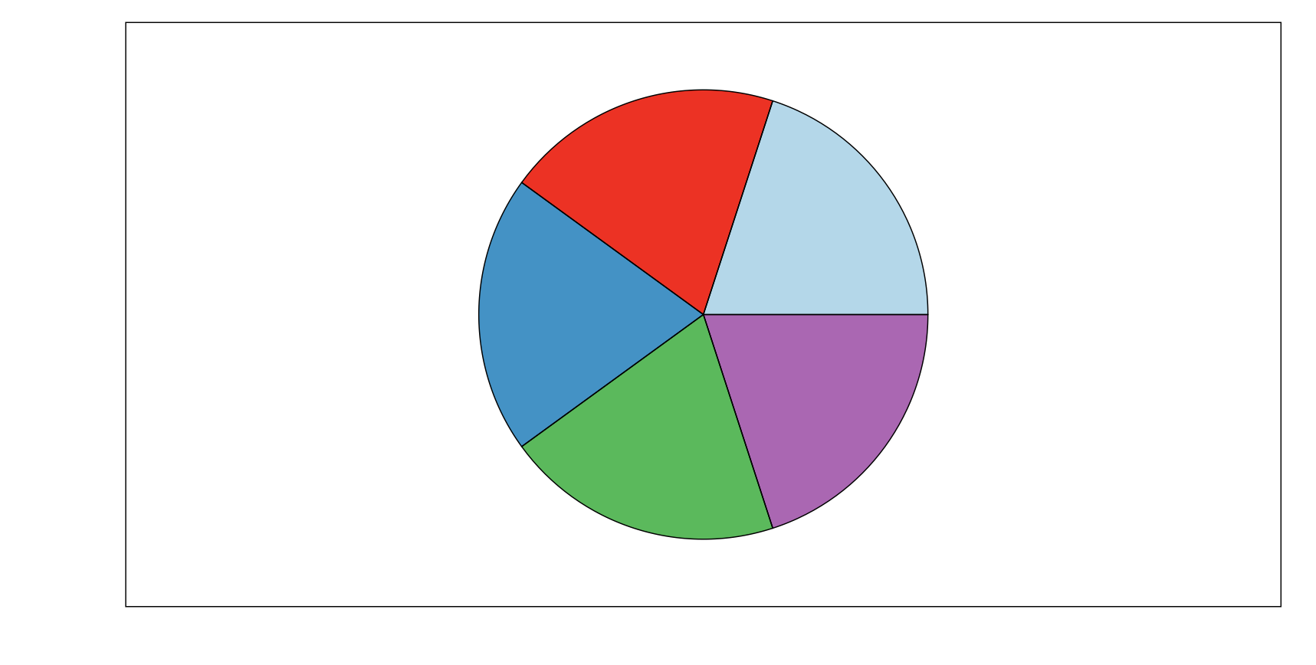
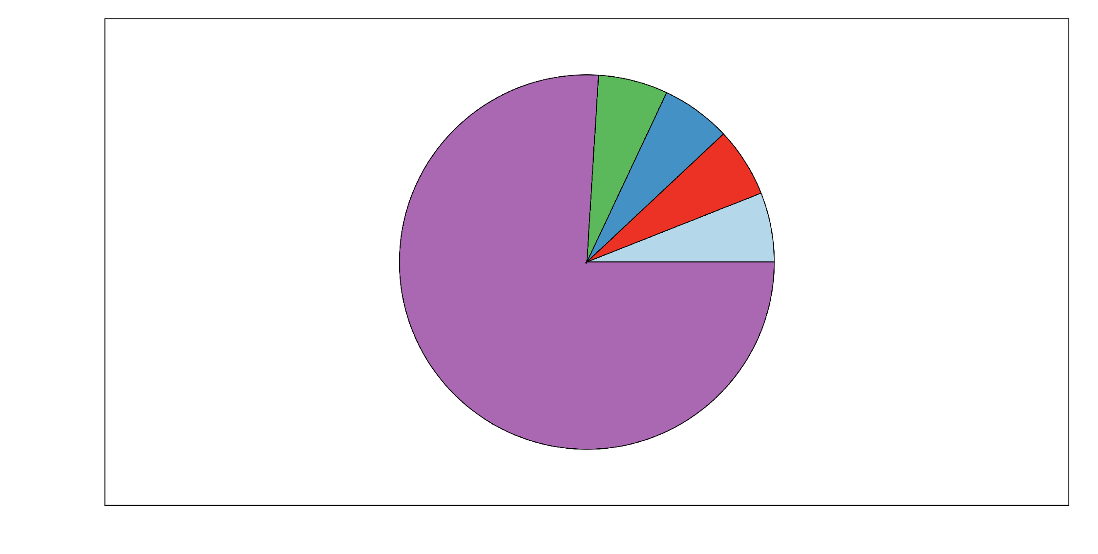
Further normalization steps need to be taken before one can compare between samples
 | Gene A | Gene B | Gene C | Gene D | Gene E | total counts
Control | 2 | 2 | 2 | 2 | 2 | 10
Treatment | 6 | 6 | 6 | 6 | 76 | 100
 | Gene A | Gene B | Gene C | Gene D | Gene E | total counts
Control | 2/10 | 2/10 | 2/10 | 2/10 | 2/10 | 10
Treatment | 6/100 | 6/100 | 6/100 | 6/100 | 76/100 | 100
 | Gene A | Gene B | Gene C | Gene D | Gene E | total counts
Control | 0.2 | 0.2 | 0.2 | 0.2 | 0.2 | 10
Treatment | 0.06 | 0.06 | 0.06 | 0.06 | 0.76 | 100
Control
Treatment
every gene appears to be differentially expressed!

Slide 47

Further normalization steps need to be taken before one can compare between samples
 | Gene A | Gene B | Gene C | Gene D | Gene E | total counts*
control | 2 | 2 | 2 | 2 | 2 | 8*
treatment | 6 | 6 | 6 | 6 | 76 | 24*
 | Gene A | Gene B | Gene C | Gene D | Gene E | total counts*
control | 2/8 | 2/8 | 2/8 | 2/8 | 2/8 | 8*
treatment | 6/24 | 6/24 | 6/24 | 6/24 | 76/24 | 24*
 | Gene A 100kb | Gene B 50kb | Gene C 25kb | Gene D 5kb | Gene E 1kb | Total RPK
control | 0.25 | 0.25 | 0.25 | 0.25 | 0.25 | 8
treatment | 0.25 | 0.25 | 0.25 | 0.25 | 3.17 | 24*
Control
Treatment
most current normalization methods attempt to find a set of genes with minimal variance across samples for normalization

Slide 48
Statistical tools for normalization and differential expression analysis make certain assumptions about your data
Key assumptions
Most genes are not differentially expressed (implications for comparing very different treatments/conditions)
Approx. equivalent numbers of up and down regulated genes
Notes:
when will these assumptions not true?
tools for normalization have their limitations

Slide 49
End of Part 1
Notes:
start with R

Slide 50
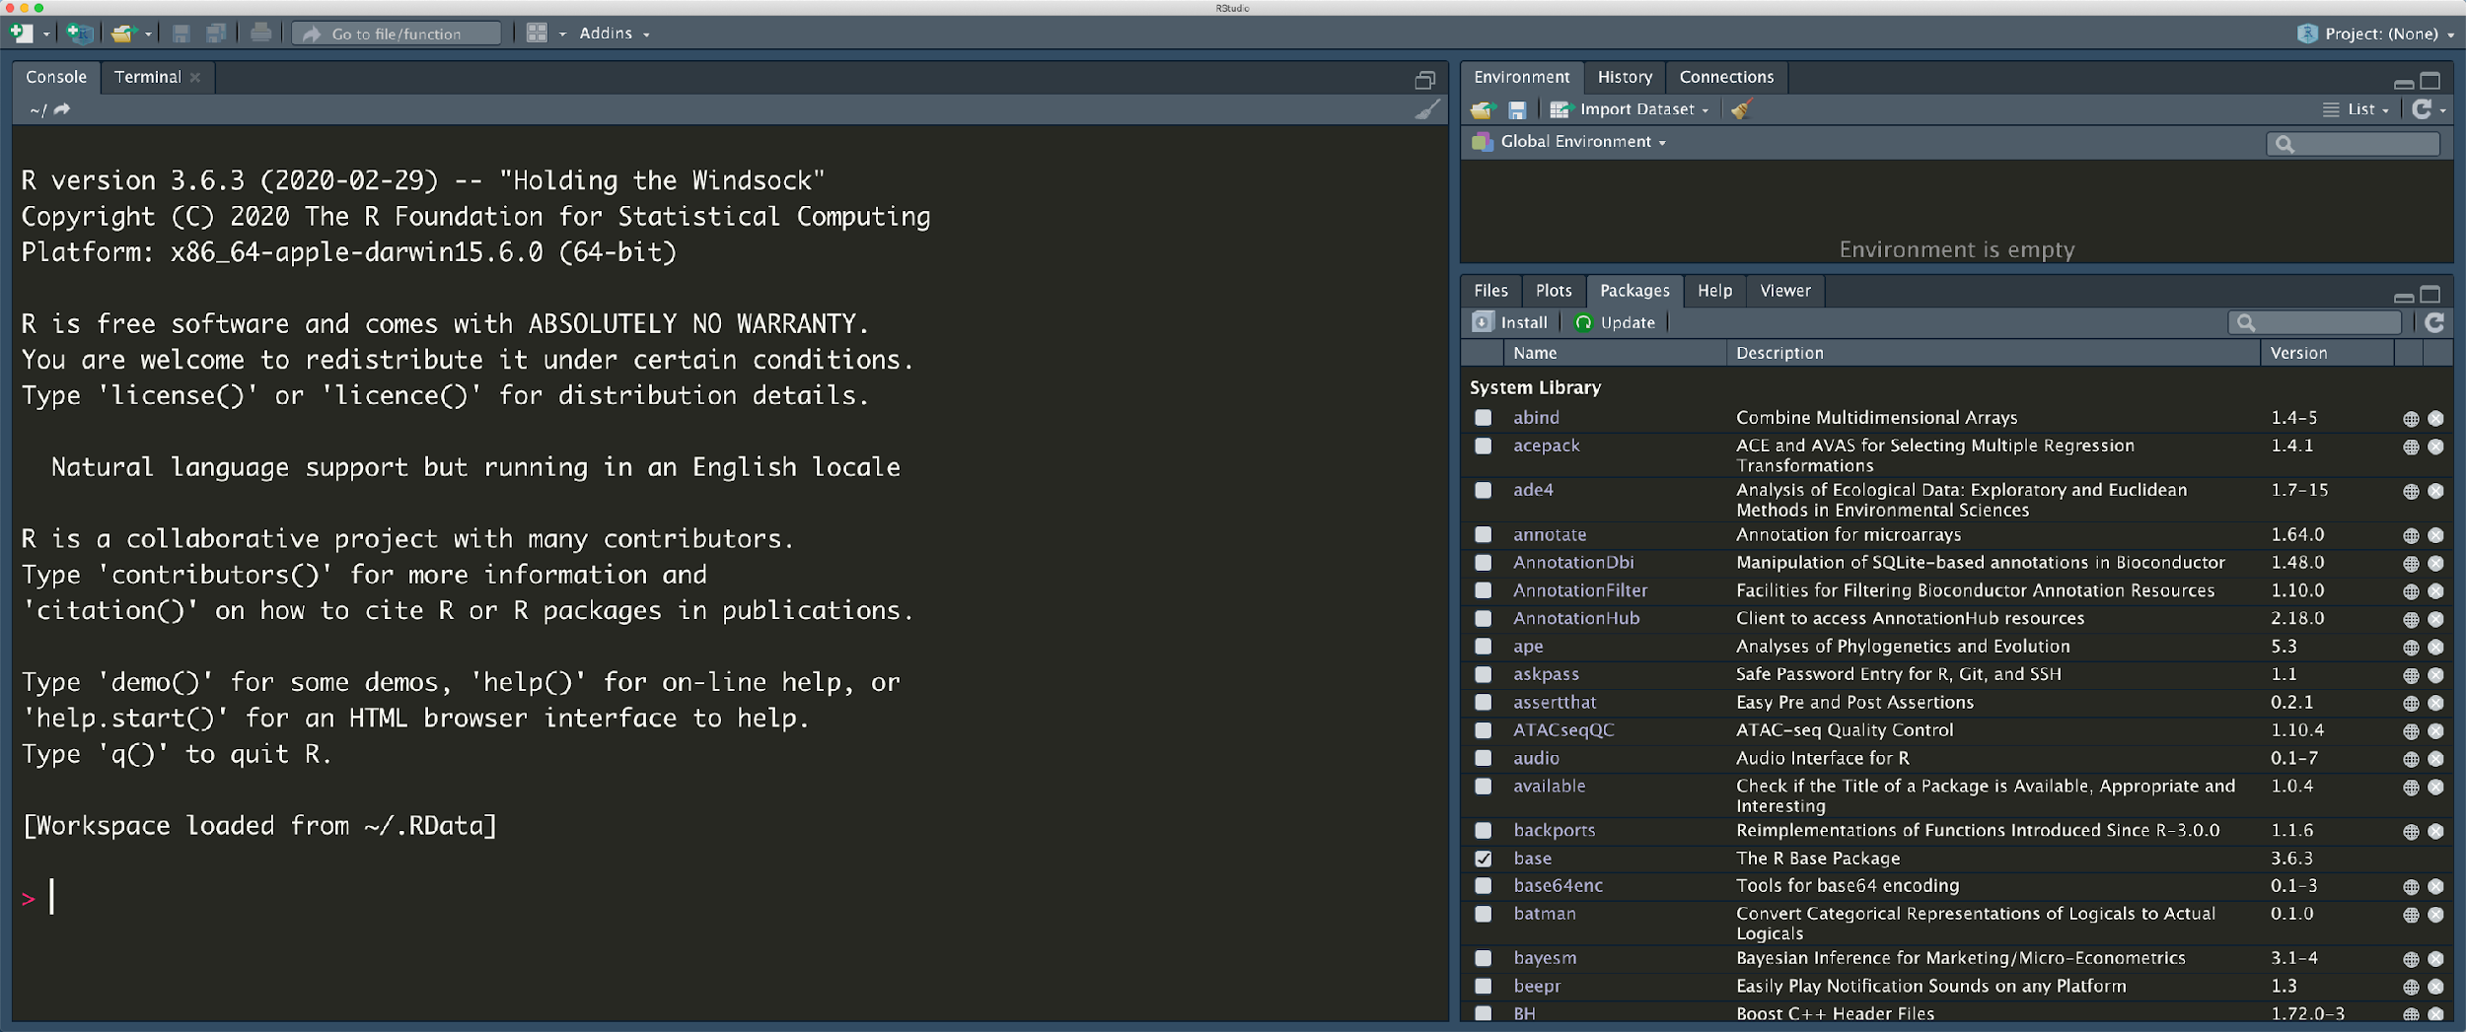

Setting up our analysis project
Notes:
Concept of an RStudio Project

Slide 51
R projects
A new R session (process) is started
The .Rprofile file in the project's main directory (if any) is sourced by R
The .RData file in the project's main directory is loaded (if project options indicate that it should be loaded).
The .Rhistory file in the project's main directory is loaded into the RStudio History pane (and used for Console Up/Down arrow command history).
The current working directory is set to the project directory.
Previously edited source documents are restored into editor tabs
Other RStudio settings (e.g. active tabs, splitter positions, etc.) are restored to where they were the last time the project was closed.
Notes:
Concept of an RStudio Project

Slide 52
R script ≠ RStudio project

Slide 53
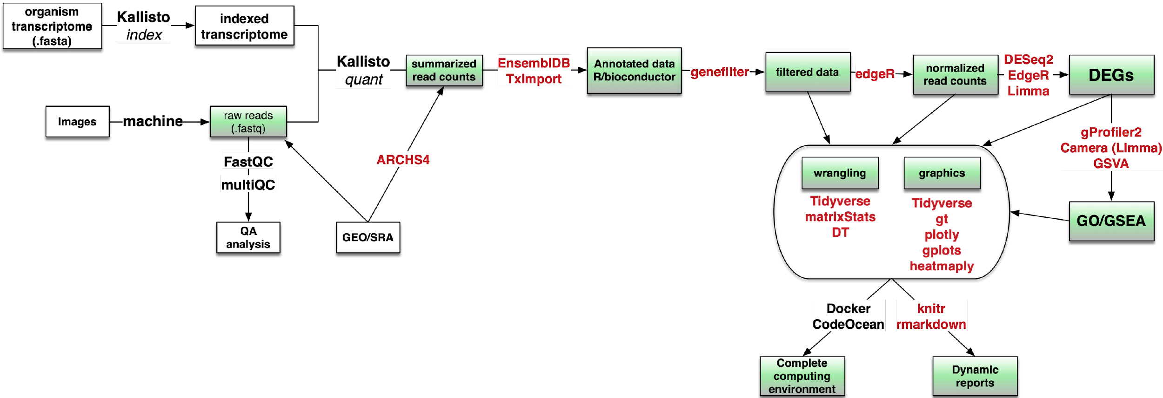
We’ll break up our analysis into ‘step’ scripts
1
2
2
5
6
7
3
4
8

Slide 54

A homework assignment
https://app.datacamp.com/learn/courses/introduction-to-the-tidyverse
https://github.com/LukaIgnjatovic/DataCamp_-_Track_-_Data_Scientist_with_R_-_Course_03_-_Introduction_to_the_Tidyverse

